Slide 1

K. K. Wagh Institute of Engineering and Education Research
Dept. Of Computer Engineering
Automation of a Wheelchair Mounted Robotic Arm using Computer Vision Interface
Guided by-
Prof. S. D. Jadhav
By-
Jayashree Ahire, TE- B (02)
A.Y. 2018-19 Semester II

Slide 2
I. INTRODUCTION
Robotic arm is developed for people suffering from upper body movement disorders such as:
Amyotrophic lateral sclerosis (ALS)
Parkinson’s disease
Progressive muscular atrophy (PMA)
Enhances the manipulation capabilities for electric wheelchair users
More independent
Pick up objects from a table or a shelf effortlessly in a short amount of time
Wheelchair mounted robotic arms utilize remote controlled interface such as joystick to control the arm
Automation of a Wheelchair Mounted Robotic Arm using Computer Vision Interface

Slide 3
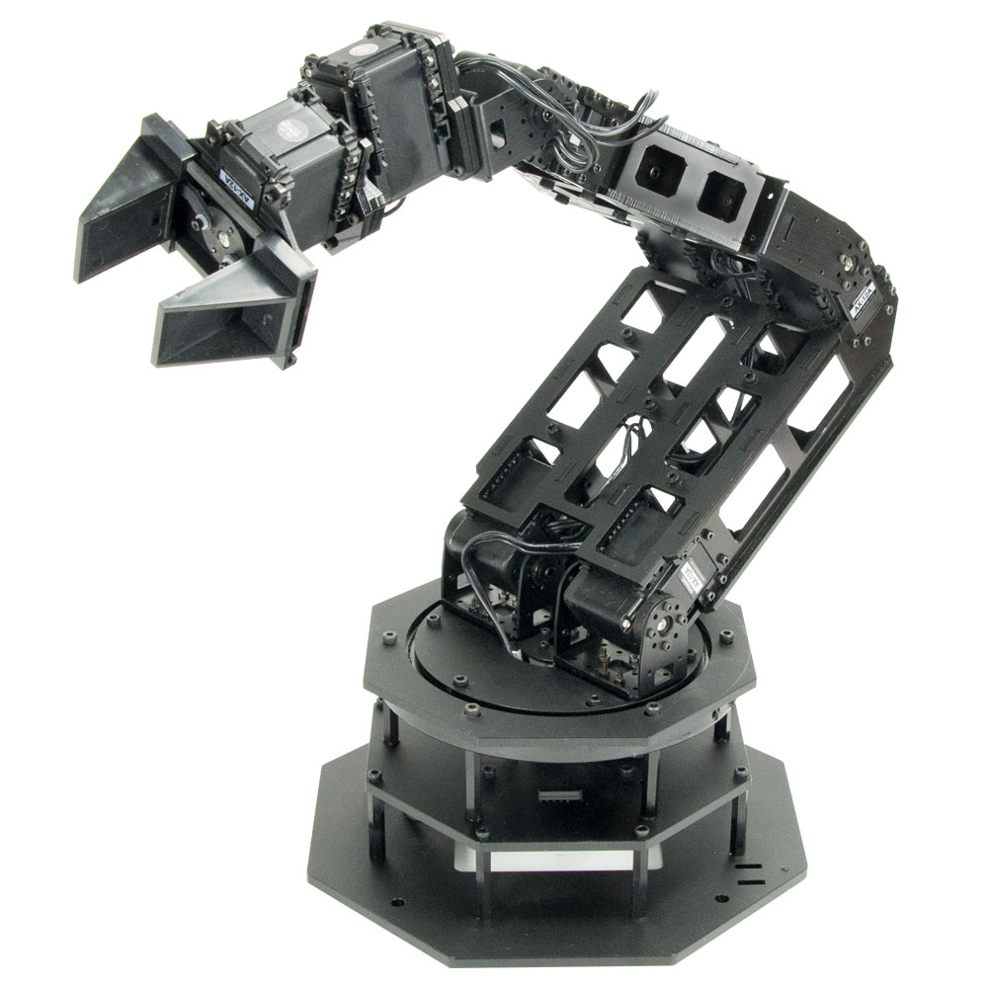
Objectives
To develop a system that can:
Deliver the desired object to the user with minimal to no supervision
Be user independent
Figure out the position of the object on its own
Use an object detection algorithm
Complete the task of picking up the object and returning it to the user under one minute
Automation of a Wheelchair Mounted Robotic Arm using Computer Vision Interface

Slide 4
Similar Products available:
Wheelchair mounted robotic arms (WMRA) available in the market:
JACO Robot arm by Kinova Robotics
iARM by Assistive Innovations
Indika Pathirage et. al. implemented Brain- Computer Interface(BCI)
Hairong Jiang et. al. performed object detection using Speeded Up Robust Features (SURF)
Most of the interfaces are:
Semiautomatic
Use mostly touch screen, joystick and graphic display
Utilize remote controlled interface such as joystick to control the arm.
Require certain level of concentration and participation from the user.
Their completion times are also usually longer (around 200 to 300 seconds)
Automation of a Wheelchair Mounted Robotic Arm using Computer Vision Interface

Slide 5
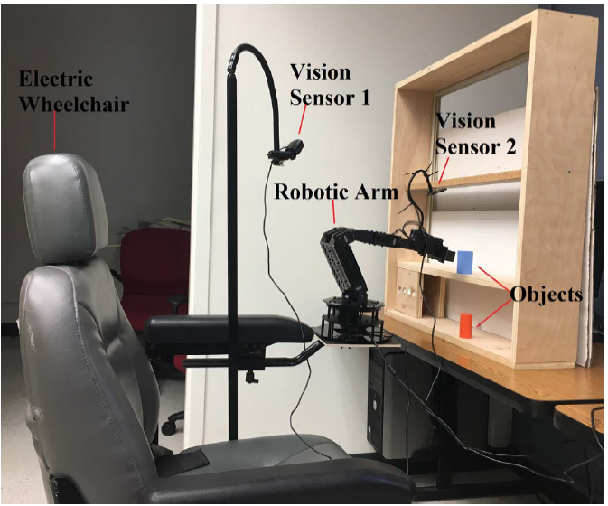
II. SYSTEM DESCRIPTION
The proposed system consists of:
a robotic arm with six degrees of freedom
an electric wheelchair
a computer system
two vision sensors
Figure 1. Image of the robotic arm mounted on an electric wheelchair
Automation of a Wheelchair Mounted RoboticArm using Computer Vision Interface

Slide 6
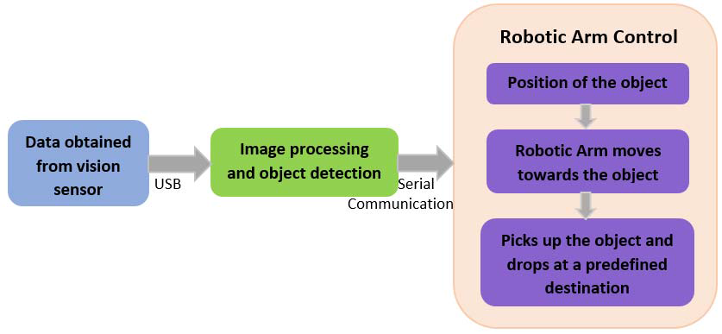
Figure 2. Block diagram of the system
System Architecture
Automation of a Wheelchair Mounted Robotic Arm using Computer Vision Interface

Slide 7
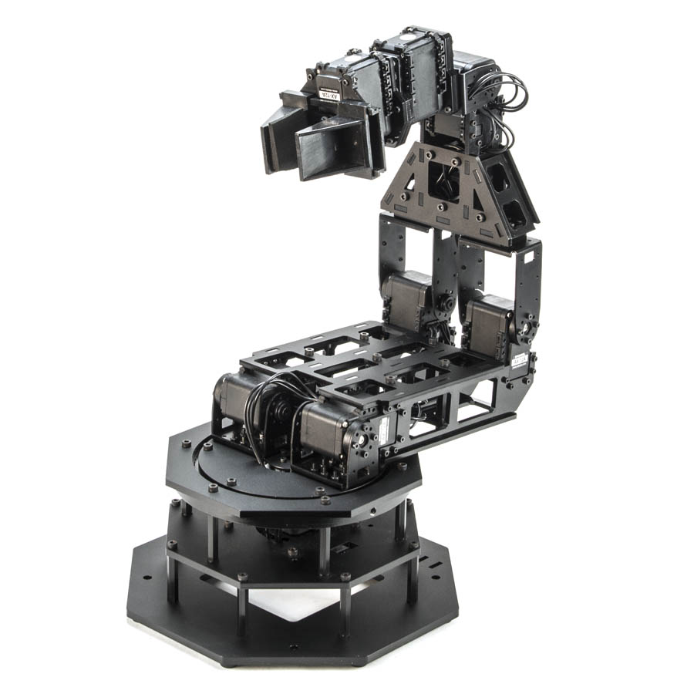
A. Robotic Arm
A Trossen Robotics PhantomX Reactor Robot Arm
Built using an Arduino compatible advanced microcontroller called Arbotix-M robocontroller
has eight AX-12A dynamixel actuators for controlling different parts of the arm
Each servo has sensors to track its
speed
Temperature
shaft position
voltage
load.
Automation of a Wheelchair Mounted Robotic Arm using Computer Vision Interface

Slide 8
Robotic Arm (cntd…)
The arm has a parallel gripper controlled by an AX-12 servo which can hold and release the object
The arm is powered by a 12V 5amp power supply and is connected to a computer system via a FTDI cable
Servo No | Position | Axis along Degrees of freedom
1 | Bottom | Horizontal(Left- Right)
2, 3 | Shoulder | Backward- Forward
4, 5 | Elbow | Vertical(Up- Down)
6, 7 | Wrist angle, rotate
Automation of a Wheelchair Mounted Robotic Arm using Computer Vision Interface

Slide 9
Communication of arm and processor
A serial connection: between the computer system and robotic arm in order to communicate with the robotic arm
This was achieved by using PySerial, a python serial port access library
The serial connection has a baud rate of 38400
The data packet which is 17-byte long was sent serially from the computer to the Arbotix-M robocontroller to control the movement of the arm
Each of the servo motor can be controlled by varying the 17-byte data sent to the arm
A short delay is introduced after every serial write command is performed
Automation of a Wheelchair Mounted Robotic Arm using Computer Vision Interface

Slide 10
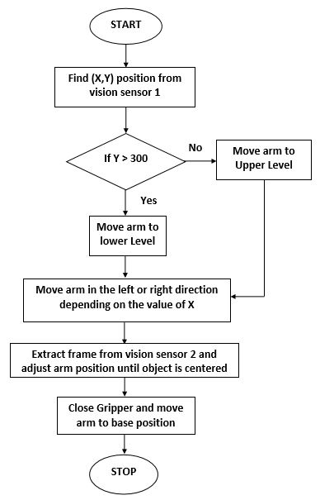
Figure 6. Flowchart for Robotic Arm Control
Working of robotic arm
Automation of a Wheelchair Mounted Robotic Arm using Computer Vision Interface

Slide 11
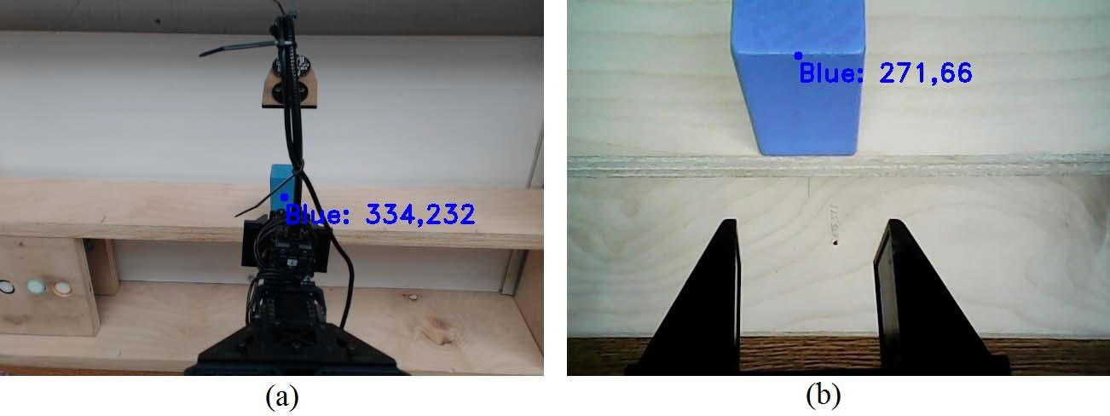
B. Vision Sensors
Vision sensor 1: Logitech HD c920 webcam
The position of this vision sensor is static
Mounted above the robotic arm facing the shelf located in front of the arm
Captures the video of the arm and the shelf in real time
Frames extracted from this video are processed
Thus, position (x, y) of the target object is calculated
This data is used for coarse positioning of the robotic arm
Automation of a Wheelchair Mounted Robotic Arm using Computer Vision Interface

Slide 12
B. Vision Sensors (cntd…)
Vision Sensor 2: robot vga webcam
Dynamic
Follows vision sensor 1
Mounted above the gripper using a 200 mm gooseneck
Fine tunes the position of the arm’s gripper before it can pick the object
The position varies depending on the position of the target object
Captures a close-up video of the target object
Used to position the gripper exactly in front of the object so that the object can be picked up correctly
Automation of a Wheelchair Mounted Robotic Arm using Computer Vision Interface

Slide 13
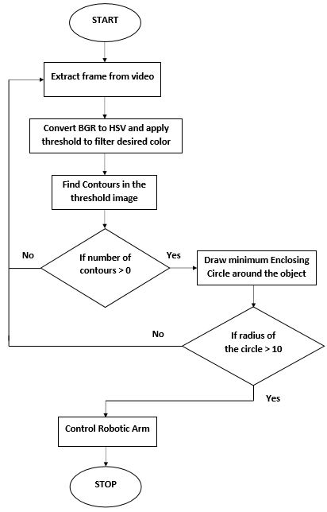
Figure 3. Flowchart for Computer Vision Algorithm:
C. Computer Vision Algorithm
Programmed to move towards the position of a specific colored object
The color detection algorithm is written in Python using the OpenCV library
The vision sensor captures the real time video of the robotic arm and the object
Automation of a Wheelchair Mounted Robotic Arm using Computer Vision Interface

Slide 14
III. EXPERIMENT AND RESULTS
The robotic arm is operated in the Cartesian mode
Initially the two vision sensors start capturing the video in real time
possibility of the arm to move to the same position repeatedly is eliminated
A best fit equation of a line is formulated
X position of the arm = (X object * 0.95) + 150 ….(Equation 1)
Automation of a Wheelchair Mounted Robotic Arm using Computer Vision Interface

Slide 15
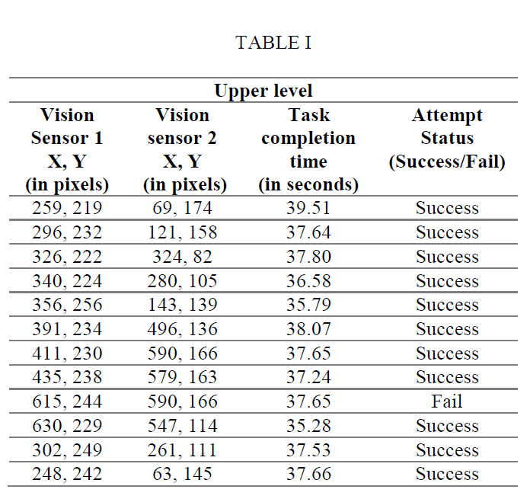
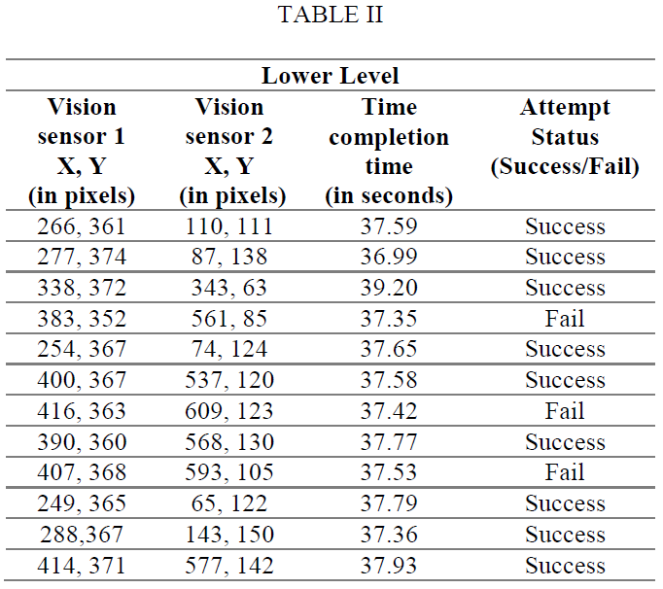
The object is picked up by closing the gripper and the arm then moves in front of the user to deliver the object
Out of the 24 trials performed with the objects in the upper and lower level, 20 were successful in picking up the objects correctly
Automation of a Wheelchair Mounted Robotic Arm using Computer Vision Interface

Slide 16
Inference
Accuracy is lesser for x values lesser than 200 or greater than 570. Hence equation (1) does not hold good for extreme values
Effective solutions for reducing the number of unsuccessful attempts would be:
formulating a higher order equation that can hold good for most locations of the object and
More fine tuning by repetitively moving the arm until the object is in the center of the frame.
the time taken to pick up objects from the upper and lower level are almost the same value.
This is significantly low compared to the completion times calculated when using brain computer interface or gesture based recognition
Automation of a Wheelchair Mounted Robotic Arm using Computer Vision Interface

Slide 17
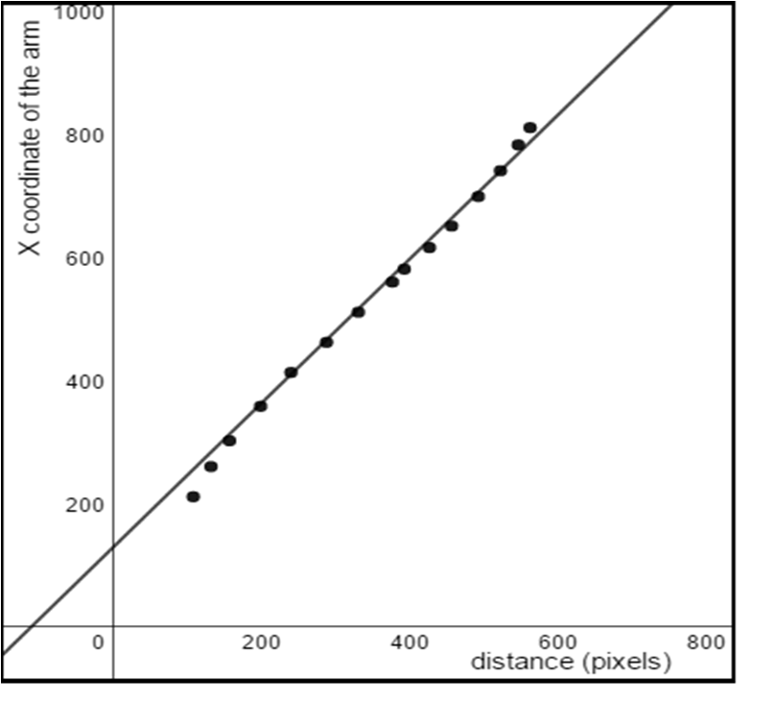
Figure 5. X distance in pixel vs X coordinate of the robotic arm
Automation of a Wheelchair Mounted Robotic Arm using Computer Vision Interface

Slide 18
It can also be seen that attempts are more successful when the objects are placed at the upper level compared to the lower level
The reason for unsuccessful attempts on the lower level is that the light falling on the lower level is less due to the shadow cast by the shelf.
the completion time for task took around 120 to 130 seconds for a skilled user.
The result shows that automating the movement of a robot arm can save a lot of time
it does not require the user to concentrate while performing the task.
Automation of a Wheelchair Mounted Robotic Arm using Computer Vision Interface

Slide 19
Advantages
Cost- effective
Faster
Puts less strain on user
Decreases dependency
Success rate of 83.33%
Completion of task achieved in 37.52 seconds on average
Automation of a Wheelchair Mounted Robotic Arm using Computer Vision Interface

Slide 20
Disadvantages
Attempts are more successful when the objects are placed at the upper level compared to the lower level
Position of the detected object keeps fluctuating due to insufficient light
Working depends mostly on the amount of light percieved from the object
Automation of a Wheelchair Mounted Robotic Arm using Computer Vision Interface

Slide 21
IV. CONCLUSION
Computer vision algorithm based on colour detection has been developed
Two sensors were used:
First sensor was used for obtaining the coarse location of the object
second one was used for fine localization
Ability to pick up objects placed at different locations on success rate of 83.33%
The main goal of performing the action of picking up the object under one minute is achieved
Automation of a Wheelchair Mounted Robotic Arm using Computer Vision Interface

Slide 22
V. FUTURE WORK
Future work aimed is implementing:
The wireless protocol
Voice recognition
mind-controlled robotic arm
Depth sensors can be used in addition to vision sensors
Advanced vision algorithms
Automation of a Wheelchair Mounted Robotic Arm using Computer Vision Interface

Slide 23
References
https://ieeexplore.ieee.org/document/8409518
https://www.trossenrobotics.com/p/phantomx-ax-12-reactor-robot-arm.aspx
https://www.semanticscholar.org/paper/Automation-of-a-wheelchair-mounted-robotic-arm-Karuppiah-Metalia/4ecb3b9209af1f837ed4e7782e560d27b2495959
https://www.youtube.com/watch?v=7fdcncalXHc
https://www.youtube.com/watch?v=EjH38p9Nnp4

